Slide 1
Research Grant Financial Status Tracker
Customer: Professor Malek-Madani
Email: rmm@usna.edu
Faculty Advisor: LCDR Kenney
Email: kenney@usna.edu
Phone: (410)-293-6810

Slide 2
Apps Linking Midshipmen and Officers
Micky Hall - CS/IT major - Team Lead
Scott Gibson - CS/Quan Econ Major
Sam Coons - CS major
Nick Arnold - IT major
Brandon Pullig - CS/IT major

Slide 3
Encompassing Areas
Databases - IT360 (Hall, Pullig, Arnold)
Information Assurance - IT430 (Hall, Pullig, Arnold)
Networking - IC322 (All members)
Adv. Web Programming - IT452 (Hall, Pullig, Arnold)
Computer Security - IC411 (All members)
Algorithms - SI335(Coons, Gibson, Hall, Pullig)

Slide 4
What we aim to do
We will build a user friendly environment for tracking the status of all active financial research grants that the Academy receives. Whether you received 100 dollars for the printing of your math research paper, or a million dollars for advanced aerodynamic materials testing you will be able to log in to our system via a user friendly web site and be able to easily record and track all of your funding intake, and also your expenditures, without having to worry about keeping a mass of documents for your records.

Slide 5
How This Process is Currently Handled
To the best of our knowledge, this process is currently handled by pen and paper. The research department will issue all documents that staff members need for tracking their research money, and then they continuously pass these shared documents back and forth whenever an update is needed.

Slide 6
Why this deserves to be a Capstone Project
Team Member | Specific Growth Areas and Discussion
M.S. Hall | Advanced Database Operability. MIDN Hall’s focus will be on the interoperability of multiple databases and creating abstract, configurable, and secure databases from a web interface. Although he has already taken Databases this will travel far outside of the scope of that class in terms of complexity.
S.M. Gibson | Document and Website Security. MIDN Gibson’s will be on maintaining a secure environment where faculty member’s can input important financial documents. He will put into practice concepts learned in Computer Algorithms and Networks class as well as discover new methods of effectively retrieving information from a database.

Slide 7
Why this deserves to be a Capstone Project
Team Member | Specific Growth Areas and Discussion
B.S. Pullig | Customer Interaction and Website Structure. MIDN Pullig will gather feedback from user testing and change the product fluidly, which is reflective of legitimate product development. Furthermore, he will expand on topics learned in previous classes to create a strong website structure that is both secure and reliable.
S.W. Coons | Efficient Algorithm Use. MIDN Coons will focus on ensuring that as much of the database retrieval methods and website are constructed to be as efficient as possible. He will expand upon the basics he learned in Algorithms class. He will also challenge himself to make a concurrent safe retrieval/insertion process.
N.P. Arnold | Web Interface and Design. MIDN Arnold will use techniques and abilities attained through 2 semesters of web to create a front end design that is both adequately functional and user friendly for our customer. He will also attempt to create an object oriented version of the styling using new technicues that he is studying.

Slide 8
External Resources
MySQL - For holding all of our financial records
Web Server - This will be needed to host our web page which will act as our portal to the financial data
Financial Records - We will need a basis to structure our databases

Slide 9
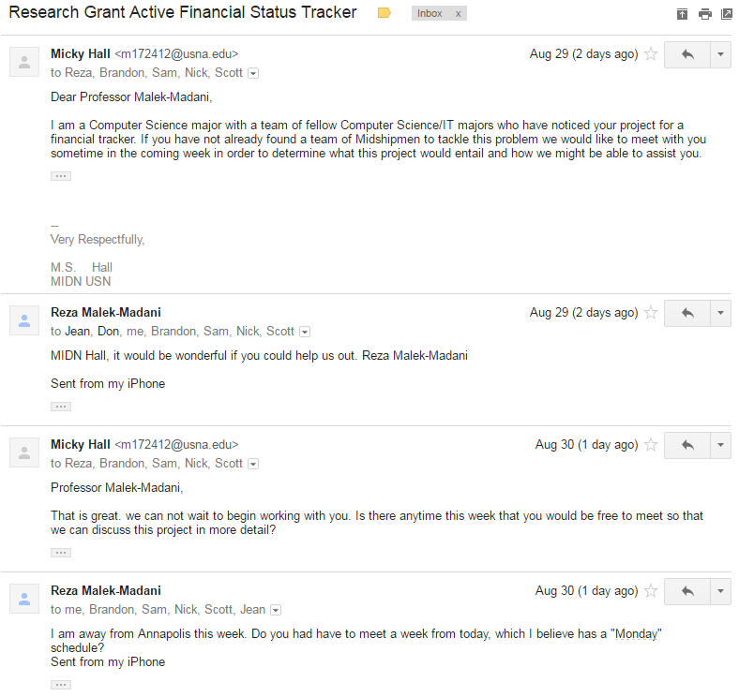
Discussion with professor Malek-Madani

